Slide 1
FINANCIAL INSTITUTIONS AND MARKETS
GROUP - 13
ASSIGNMENT -2
P. ABHISEK RAO - 17CH3FP17
UNNIKRISHNAN - 17NA3FP14
NAMAN SULTANIA- 19ME30029

Slide 2
CURRENT SCENARIO OF INDIAN MUTUAL FUNDS INDUSTRY

Slide 3
WHAT ARE MUTUAL FUNDS:
A MUTUAL FUND IS A FINANCIAL VEHICLE MADE UP OF A POOL OF MONEY COLLECTED FROM INVESTORS TO INVEST IN STOCKS, BONDS, MONEY MARKET, ETC.
MUTUAL FUNDS ARE OPERATED BY PROFESSIONAL MONEY MANAGERS, WHO HEDGE AND ALLOCATE THE FUND’S ASSETS ALL IN AN ATTEMPT TO PRODUCE CAPITAL GAINS OR INCOME FOR THE FUND’S INVESTORS.
MUTUAL FUNDS ARE DIVIDED INTO SEVERAL CATEGORIES, REPRESENTING THE KINDS OF SECURITIES THEY INVEST IN, THEIR INVESTMENT OBJECTIVES, AND THE TYPE OF RETURNS THEY SEEK, ETC.

Slide 4
WHEN IT ALL STARTED:
THE MUTUAL FUND INDUSTRY BEGAN IN INDIA WHILST SETTING UP THE UNIT TRUST OF INDIA (UTI)
SBI MUTUAL FUND BECAME THE FIRST NON - UTI MUTUAL FUND IN INDIA
1963
1987
2020
THE UTI WAS SET UP AS AN INITIATIVE OF GOVERNMENT OF INDIA AND RESERVE BANK OF INDIA (RBI)
ON A BOOM !!

Slide 5
MARKET OVER THE YEARS
2010
2014
THE ASSETS UNDER MANAGEMENT (AUM) OF INDIAN MUTUAL FUND INDUSTRY STOOD AT INR 6.57 TRILLION ON SEPTEMBER 30, 2010
THE AUM REACHED ITS FIRST MILESTONE OF INR 10 TRILLION ON MAY 30, 2014, IN A SHORT SPAN OF ABOUT 4 YEARS

Slide 6
MARKET OVER THE YEARS
2017
2020
THE AUM INCREASED MORE THAN TWO FOLDS TO INR 20 TRILLION FOR THE FIRST TIME ON AUGUST 30, 2017
THE AUM HAS BEEN ON A RISING SPREE CURRENTLY AT INR 28 TRILLION ( USD 365 BILLION) ON SEPTEMBER 30, 2020

Slide 7
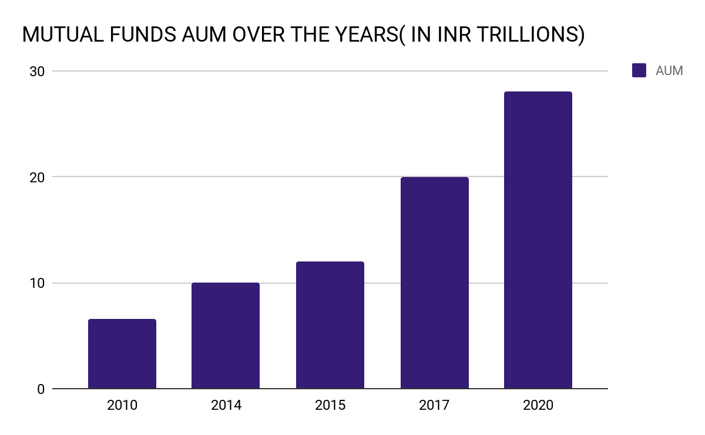
MARKET OVER THE YEARS

Slide 8
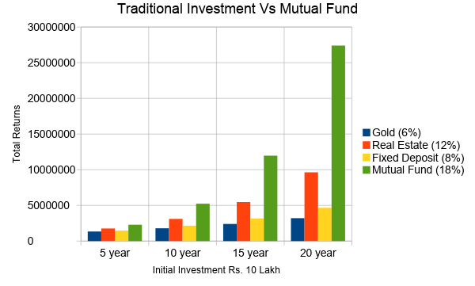

Slide 9
REGULATORY BODIES:
MUTUAL FUNDS ARE PRIMARILY REGULATED BY SECURITIES AND EXCHANGE BOARD OF INDIA(SEBI) IN ACCORDANCE WITH RBI
RBI SUPERVISES OPERATION OF FUNDS OWNED BY BANKS
REGULATES MUTUAL FUNDS DEALING EXCESSIVELY WITH THE MONEY MARKET.
FORMULATES KNOW YOUR CUSTOMER (KYC) INFORMATION.WITHOUT COMPLYING WITH KYC NORMS NO INVESTOR CAN INVEST IN MUTUAL FUNDS.

Slide 10
SEBI:
SEBI IS THE PRIMARY REGULATOR OF MUTUAL FUND INDUSTRY IN INDIA. ALL MUTUAL FUNDS HAVE TO REGISTER THEMSELVES WITH SEBI.
MUTUAL FUNDS ARE GOVERNED UNDER A SET OF REGULATIONS CALLED SECURITIES AND EXCHANGE BOARD OF INDIA (MUTUAL FUNDS) REGULATIONS, 1996 WHICH HAVE BEEN DESIGNED TO PROTECT THE INTEREST OF THE INVESTORS.

Slide 11
WHAT IS AMFI:
ASSOCIATION OF MUTUAL FUNDS IN INDIA
NON- PROFIT GOVERNMENT ORGANISATION IN THE MUTUAL FUNDS’ SECTOR THAT ACTS AS A PRIMARY REGULATOR UNDER SEBI.
ASSOCIATION OF ALL THE REGISTERED ASSET MANAGEMENT COMPANIES IN INDIA.
INDUSTRY BODY THAT HAS BEEN CREATED TO DEVELOP THE INDIAN MUTUAL FUNDS INDUSTRY ON PROFESSIONAL,HEALTHY AND ETHICAL LINES.

Slide 12
ROLES AND FUNCTIONS OF AMFI:
INTERACTS AND REPRESENTS SEBI, RBI AND GOVT. ON ALL MATTERS RELATED TO MUTUAL FUND INDUSTRY.
ENSURES THAT AMCs, SPONSORS, TRUSTEES, CUSTODIAN, RTAs ALL ADHERE TO RULES AND REGULATIONS FOR FINANCIAL MARKET.
DEFINES CODE OF CONDUCT TO BE FOLLOWED BY AMCs AND ALL THE PARTIES INVOLVED IN MUTUAL FUND ACTIVITIES.
TAKES DISCIPLINARY ACTIONS FOR VIOLATION OF CODE OF CONDUCT.

Slide 13
TYPES OF MUTUAL FUNDS
MUTUAL FUNDS CAN BE BROADLY CLASSIFIED BASED ON THE FOLLOWING PARAMETERS:
MATURITY PERIOD
PRINCIPAL INVESTMENTS

Slide 14
BASED ON MATURITY PERIOD
OPEN-ENDED SCHEME
THIS SCHEME ALLOWS INVESTORS TO BUY OR SELL UNITS ANYTIME
THE KEY FEATURE HERE IS LIQUIDITY
BUY OR SELL UNITS AT NET ASSET VALUE (“NAV”) RELATED PRICES
APPROXIMATELY 59% ARE OPEN-ENDED FUNDS

Slide 15
BASED ON MATURITY PERIOD
CLOSE-ENDED SCHEME
HAVE A STIPULATED MATURITY PERIOD
INVESTORS CAN INVEST ONLY DURING THE INITIAL LAUNCH PERIOD
ONCE THE OFFER CLOSES, NO NEW INVESTMENTS WILL BE PERMITTED
MARKET PRICE COULD VARY FROM THE SCHEME’S NAV
SEBI REGULATIONS ENSURE THAT AT LEAST ONE EXIT ROUTE

Slide 16
BASED ON MATURITY PERIOD
INTERVAL SCHEME
OPERATES AS A COMBINATION OF OPEN AND CLOSED-ENDED SCHEMES
ALLOWS INVESTORS TO TRADE UNITS AT PREDEFINED INTERVALS
THEY MAY BE TRADED ON THE STOCK EXCHANGE
THEY MAY EVEN BE OPEN FOR SALE OR REDEMPTION DURING PRE-DETERMINED INTERVALS AT NAV RELATED PRICES

Slide 17
BASED ON PRINCIPAL INVESTMENTS
CONSIDERING INVESTMENT STRATEGY AND ASSET ALLOCATION, THE SCHEMES ARE BROADLY CLASSIFIED INTO THE FOLLOWING CATEGORIES:
EQUITY SCHEMES
DEBT SCHEMES
HYBRID SCHEMES
SOLUTION ORIENTED SCHEMES
OTHER SCHEMES

Slide 18
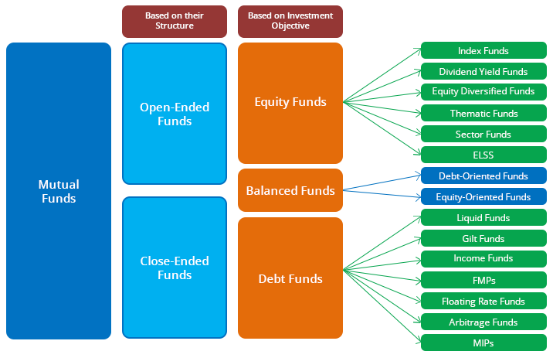
BASED ON PRINCIPAL INVESTMENTS

Slide 19
BASED ON PRINCIPAL INVESTMENTS
EQUITY SCHEMES
AT LEAST 65% OF THE SCHEME’S ASSETS MUST BE IN EQUITIES AND ERI
NO INCIDENCE OF LONG TERM CAP-GAINS TAX ON EQUITY FUNDS WHICH ARE HELD FOR AT LEAST 12 MONTHS
BROADLY CLASSIFIED INTO LARGE CAP, MID CAP AND SMALL CAP FUNDS

Slide 20
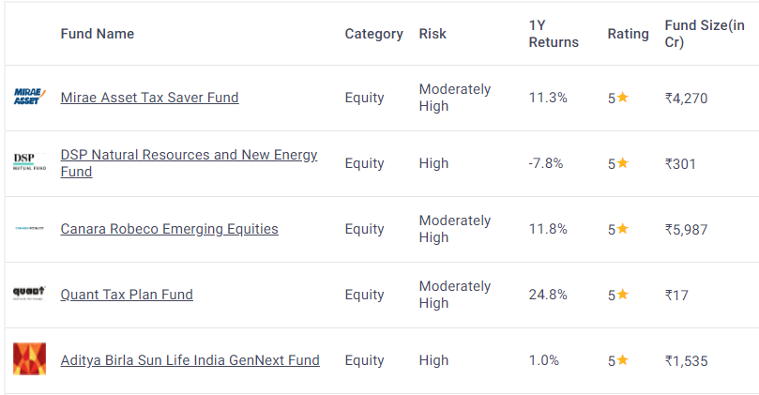
BASED ON PRINCIPAL INVESTMENTS
TOP PERFORMING EQUITY SCHEMES IN INDIA (GROWW)

Slide 21
BASED ON PRINCIPAL INVESTMENTS
DEBT SCHEMES
THESE SCHEMES INVEST IN SECURITIES WHICH GENERATE FIXED INCOME DEBT AND MONEY MARKET INSTRUMENTS
ALL THESE INSTRUMENTS HAVE A PRE-DECIDED MATURITY DATE AND INTEREST RATE
DEBT SECURITIES ARE CONSIDERED TO BE LOW-RISK VEHICLES

Slide 22
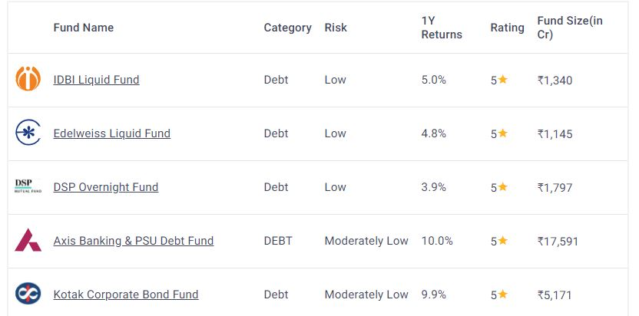
BASED ON PRINCIPAL INVESTMENTS
TOP PERFORMING DEBT SCHEMES IN INDIA (GROWW)

Slide 23
BASED ON PRINCIPAL INVESTMENTS
HYBRID SCHEMES
HYBRID FUNDS ARE A COMBINATION OF EQUITY AND DEBT INVESTMENTS
A BALANCED PORTFOLIO TO OFFER REGULAR INCOME TO ITS INVESTORS ALONG WITH CAPITAL APPRECIATION IN THE LONG-TERM
RISKIER THAN DEBT FUNDS BUT SAFER THAN EQUITY FUNDS,
OFFER BETTER RETURNS THAN DEBT FUNDS AND ARE PREFERRED BY MANY LOW-RISK INVESTORS
THE FUNDS ARE GENERALLY ACTIVE IN NATURE

Slide 24
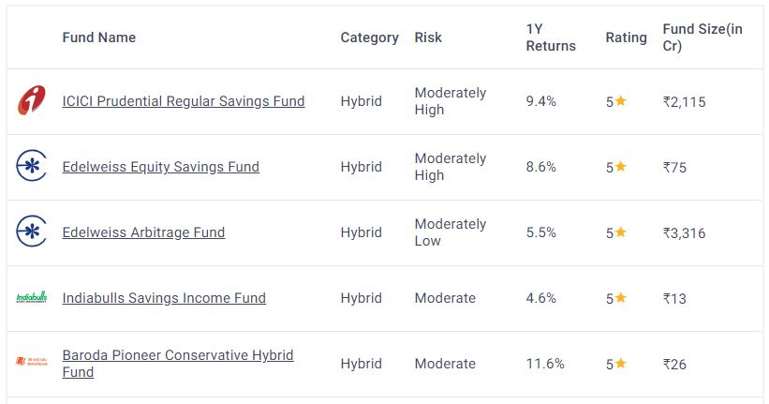
BASED ON PRINCIPAL INVESTMENTS
TOP PERFORMING HYBRID SCHEMES IN INDIA (GROWW)

Slide 25
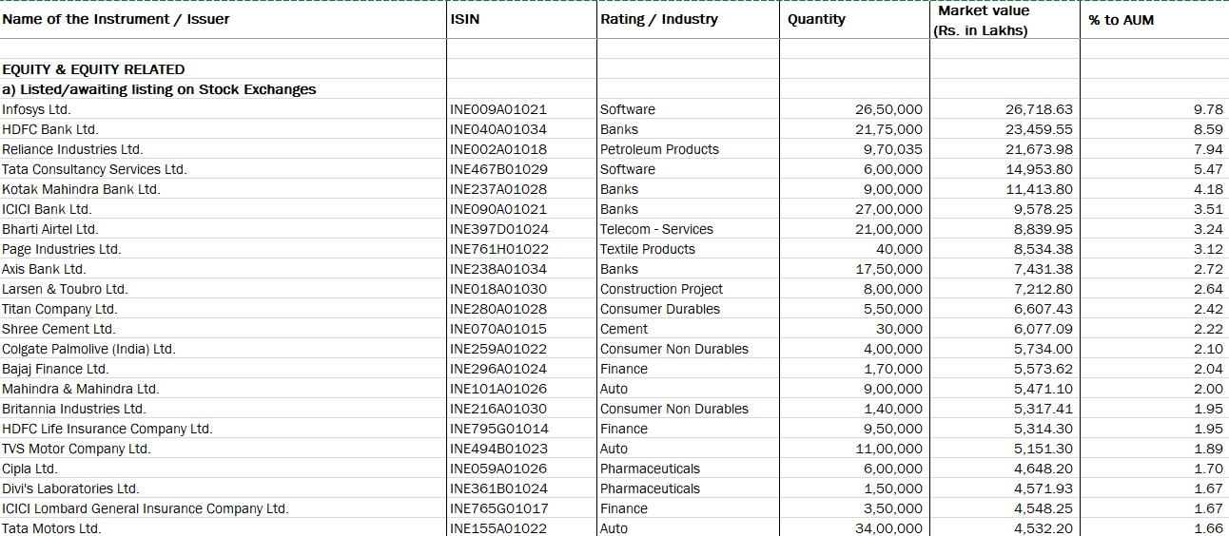
SBI MAGNUM EQUITY ESG FUND: ANALYSIS
Source: SBI

Slide 26
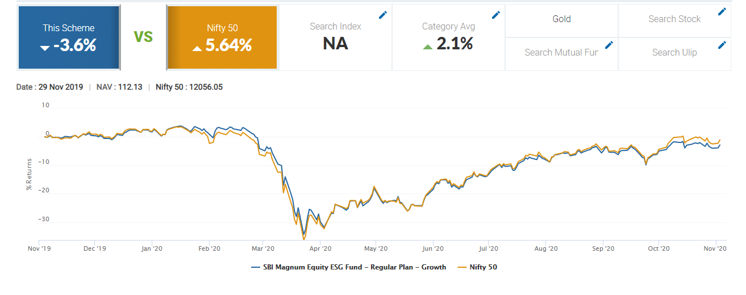
SBI MAGNUM EQUITY ESG FUND: ANALYSIS
Source: Money Control

Slide 27
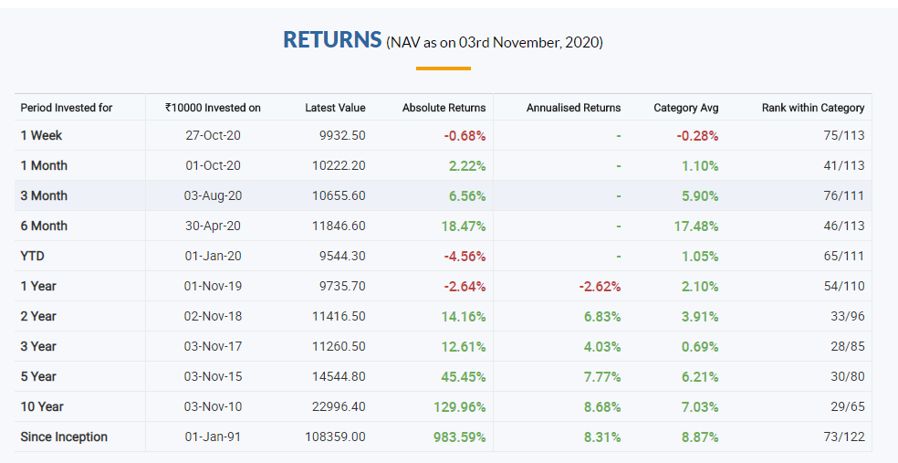
SBI MAGNUM EQUITY ESG FUND: ANALYSIS
Source: Money Control

Slide 28
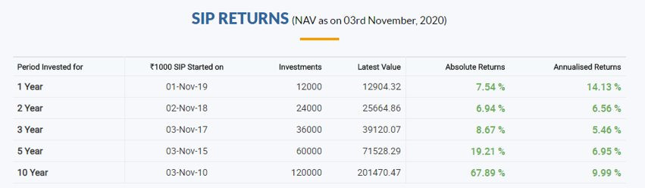
SBI MAGNUM EQUITY ESG FUND: ANALYSIS
Source: Money Control

Slide 29
CURRENT SCENARIO OF INDIAN MUTUAL FUNDS
IT HAS BEEN RATED THE BEST INVESTMENT VEHICLE FOR LONG-TERM FINANCIAL GOALS WITH A LOW RISK APPETITE AND SUBSTANTIAL GAINS BY THE COMMON MAN

Slide 30
CURRENT SCENARIO OF INDIAN MUTUAL FUNDS
THE MUTUAL FUND INDUSTRY HAS BEEN EXPERIENCING TREMENDOUS GROWTH SINCE ITS ORIGIN IN 1963.
IT IS ONE OF THE FASTEST GROWING INVESTMENT DOMAINS FOR THE COMMON MAN IN INDIAN FINANCIAL MARKETS.
THE EXPONENTIAL GROWTH LEVELS OF AUM INDICATE THE IMMENSE POPULARITY OF MUTUAL FUNDS IN THE CURRENT SCENARIO IN INDIAN MARKETS.

Slide 31
CURRENT SCENARIO OF INDIAN MUTUAL FUNDS
THE FACTORS RESPONSIBLE FOR ITS GROWTH -
RISING HOUSEHOLD SAVINGS
STRONG REGULATORY FRAMEWORK
FAVOURABLE AND STRICT TAX POLICIES
EASY-TO-USE INNOVATIVE PRODUCTS
FINANCIAL EDUCATION OF INDIVIDUALS

Slide 32
CURRENT SCENARIO OF INDIAN MUTUAL FUNDS
RISING HOUSEHOLD SAVINGS
WITH A VAST MAJORITY OF THE INDIAN POPULATION (~80%) SAVING IN FIXED DEPOSITS AND GOLD, THESE INVESTMENT VEHICLES GET HUGE A CHUNK OF THEIR MONEY FROM THESE HOUSEHOLDS.

Slide 33
CURRENT SCENARIO OF INDIAN MUTUAL FUNDS
STRONG REGULATORY FRAMEWORK
SECURITIES AND EXCHANGE BOARD OF INDIA (SEBI) HAS FRAMED VARIOUS REGULATORY MEASURES IN ORDER TO PROTECT THE MINORITY INVESTORS FOR THE LONG TERM GROWTH OF THE INDUSTRY AND THE ECONOMY OF INDIA.

Slide 34
CURRENT SCENARIO OF INDIAN MUTUAL FUNDS
FAVOURABLE AND STRICT TAX POLICIES
WITH SALARIED PEOPLE INCREASING AT A RATE OF 20%, THE TAX BENEFITS ALLOWED ON MUTUAL FUND SCHEMES, LIKE INVESTMENT MADE IN EQUITY LINKED SAVING SCHEME (ELSS) QUALIFIES FOR TAX DEDUCTIONS UNDER THE SECTION 80C OF THE INCOME TAX ACT, MUTUAL FUNDS HAVE SEEN A RISING SPREE SINCE THEN.

Slide 35
CURRENT SCENARIO OF INDIAN MUTUAL FUNDS
EASY-TO-USE INNOVATIVE PRODUCTS
WITH THE BEST IN CLASS PRODUCTS RANGING FROM EQUITY FUNDS, DEBT FUNDS TO HYBRID FUNDS. TO FORAYING INTO MONEY MARKET, SECTOR SPECIFIC, GOLD AND INDEX FUNDS, THE INDUSTRY HAS BEEN OFFERING EASY TO USE AND SCALABLE PRODUCTS.

Slide 36
CURRENT SCENARIO OF INDIAN MUTUAL FUNDS
FINANCIAL EDUCATION OF INDIVIDUALS
A MAJORITY OF THE INVESTORS IN TIER-2 CITIES AS WELL AS METROS LACK THE BASIC UNDERSTANDING OF MUTUAL FUND PRODUCTS, SINCE THEN THE EFFORTS BY SEBI AND FUNDS TO EDUCATE MORE PEOPLE INTO INVESTING LONG-TERM ETHICALLY HAS PLAYED A HUGE ROLE.

Slide 37
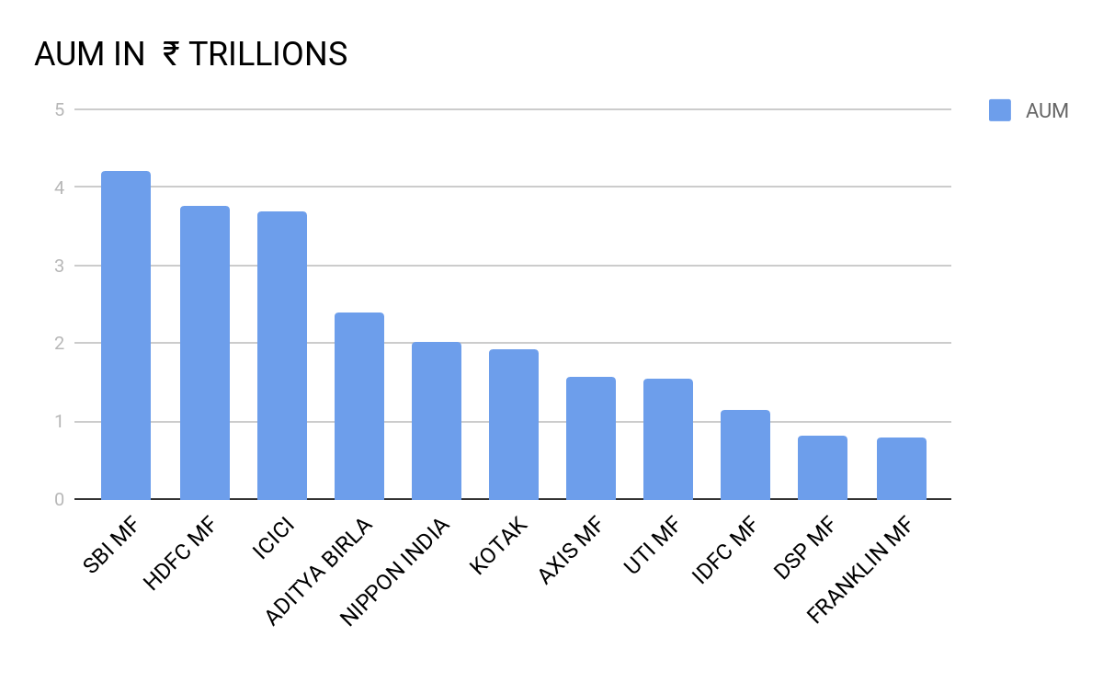
FUND WISE DISTRIBUTION OF THE TOP 10 FUNDS

Slide 38
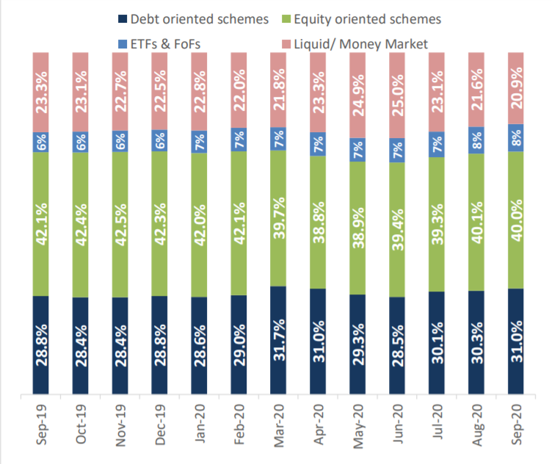
SCHEME WISE COMPOSITION

Slide 39
SCHEME WISE COMPOSITION
EQUITY ORIENTED FUNDS HAVE A PROPORTIONATE SHARE OF 40% OF THE TOTAL AUM DECREASING FROM 42% A YEAR AGO BECAUSE OF HIGHLY VOLATILE CAPITAL MARKETS RIGHT NOW DUE TO COVID.
REASON - VOLATILE CAPITAL MARKETS DUE TO COVID, HAVE FORCED MANY TO HEDGE AND CHANGE POSITIONS FROM EQUITY TO KEEP UP WITH THE GROWING RETURNS.

Slide 40
SCHEME WISE COMPOSITION
DEBT ORIENTED FUNDS HAVE A PROPORTIONATE SHARE OF 31% OF THE TOTAL AUM INCREASING FROM 28.8% A YEAR AGO BECAUSE OF HIGHLY VOLATILE CAPITAL MARKETS RIGHT NOW DUE TO COVID.
REASON - IN THESE UNPRECEDENTED TIMES OF COVID, WITH RBI DECREASING REPO RATES AS A RELIEF, DEBT MARKET INSTRUMENTS HAVE TAKEN A TOIL IN THE MARKETS.

Slide 41
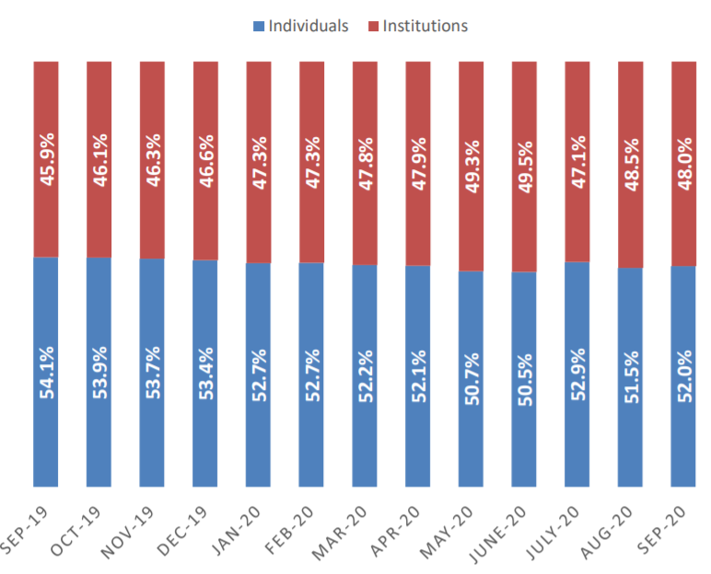
INVESTOR WISE

Slide 42
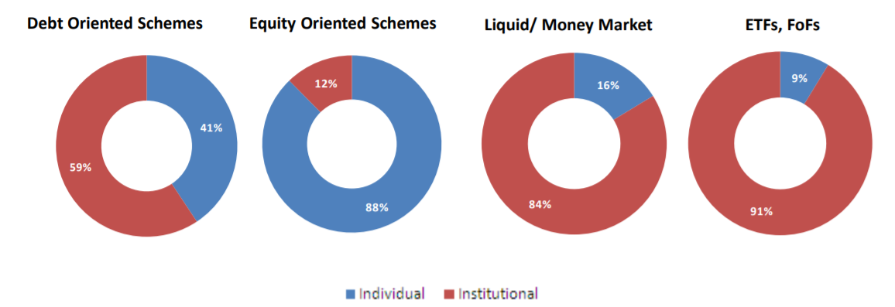
INVESTOR WISE
INDIVIDUAL - RETAIL AND HNIs
INSTITUTIONAL - INSTITUTIONS LIKE FOREIGN BANKS, INSURANCE,ETC.

Slide 43
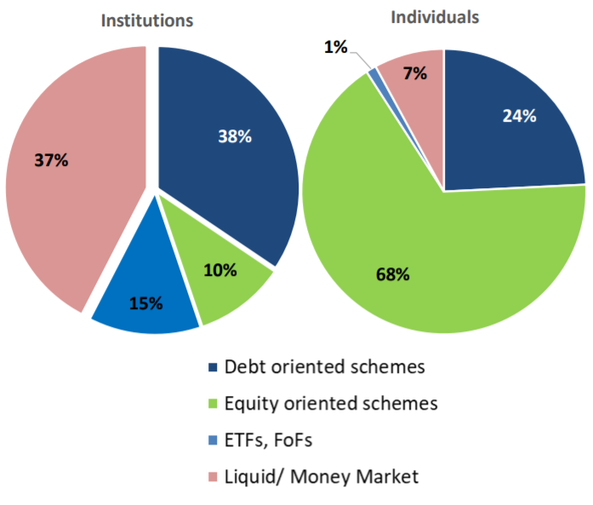

Slide 44



HOW CAN YOU INVEST AND REDEEM
NOW YOU CAN EASILY INVEST THROUGH SEBI-REGISTERED ONLINE INVESTMENT PLATFORMS VERIFYING THEIR FUND SIZE, PREVIOUS PERFORMANCES AND RETURNS OVER THE PERIOD.

Slide 45
BUY AND SELLING OF UNITS
BUYING:
IF THE ORDER IS PLACED BEFORE 1 PM, THEN THE PRESENT DAY’S NAV IS TAKEN INTO CONSIDERATION, AFTER 1 PM THE NEXT DAY’S NAV IS TAKEN.
SELLING:
IF THE ORDER IS PLACED BEFORE 12:30 PM, THEN THE PREVIOUS DAY’S NAV IS TAKEN INTO CONSIDERATION, AFTER 12:30 PM THE SAME DAY ’S NAV IS TAKEN.
NAV- NET ASSET VALUE

Slide 46
REDEMPTION CYCLE
TYPE OF FUND
EXIT LOAD (~1% VARIES)
PAYOUT DURATION ( GENERALLY 2-4 WORKING DAYS)
TAX IMPLICATION

Slide 47
MUTUAL FUNDS ARE SUBJECT TO MARKET RISKS, PLEASE READ ALL SCHEME RELATED DOCUMENTS CAREFULLY BEFORE INVESTING!!

Slide 48
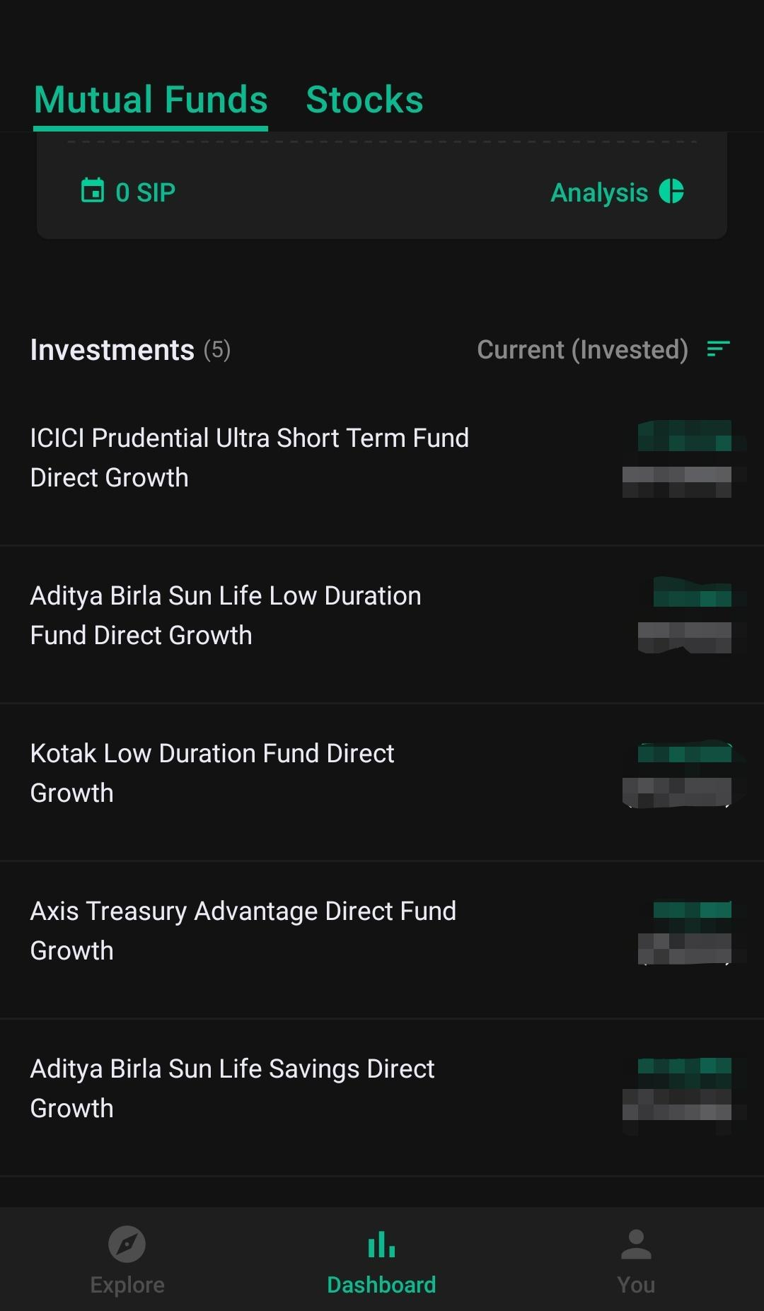
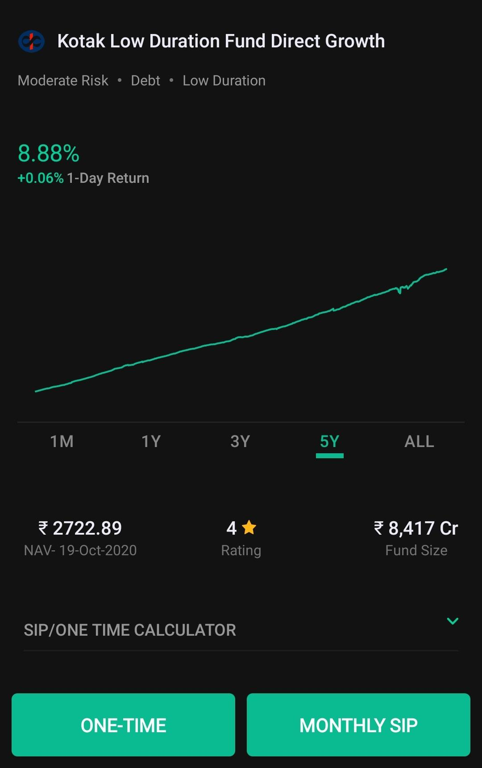
EXAMPLE OF A PORTFOLIO FOR THE LAST 8 MONTHS
LOW RISK, CONSISTENT RETURNS ON A DAY TO DAY BASIS AND A DIVERSIFIED SET WAS MY TASTE FOR THE PORTFOLIO.

Slide 49
SOURCES
https://www.amfiindia.com/indian-mutual#:~:text=Assets%20Under%20Management%20(AUM)%20of,a%20span%20of%2010%20years.
http://www.ijbm.co.in/downloads/vol3-issue1/15.pdf
https://www.amfiindia.com/Themes/Theme1/downloads/home/industry-trends.pdf
https://www.paisabazaar.com/mutual-funds/how-to-redeem-fund-units/
https://www.amfiindia.com/research-information/aum-data/average-aum

Slide 50
THANK YOU

